Slide 1




UIPATH RPA

Slide 2
Outline
UiPath Studio
UiPath Robot
UiPath Orchestrator
Next Steps

Slide 3
UiPath Studio
Is an advance visual process modeling
Straightforward drag and drop functionality and a built-in library of predefined activities greatly enhance the user’s experience and speed up the learning curve

Slide 4
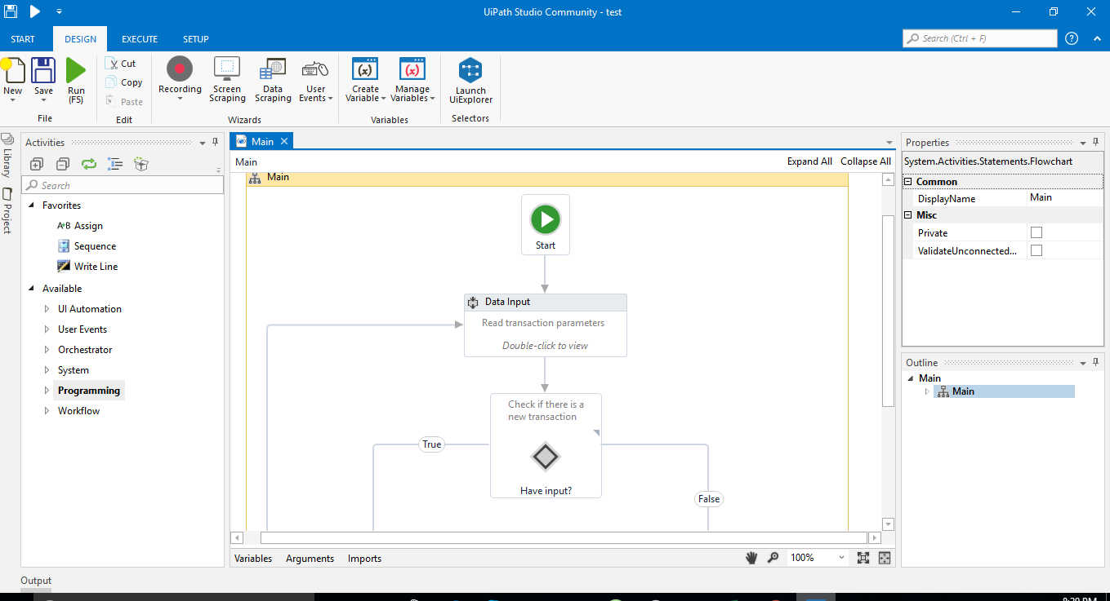
UiPath Studio

Slide 5
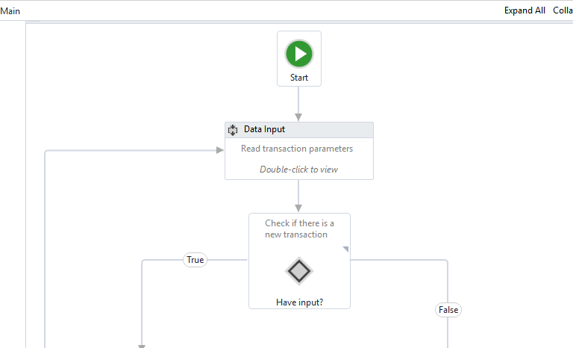
Main screen
Blank
Simple process
Agent process improvement
Transactional business process

Slide 6
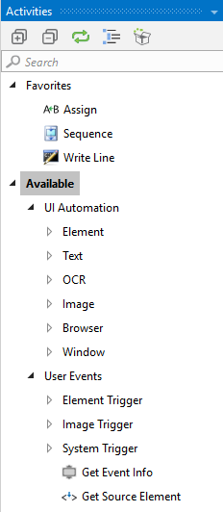
Panel
Support 300 activities allow interact with desktop application, web browser, ocr engine and so on.
Compatible with excel, pdf, and all Database types
Compatible with outlook, exchange, or any other type of email client(smpt, imap, pop3).
Can automate processes on web platforms as well, with http, soap request

Slide 7
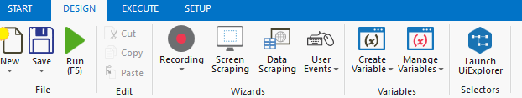
Tools
Create a workflow by using recording feature: basic, desktop, web
Support any types of desktop applications: .Net, Java, C++, Delphi, Foxpro, or other types of languages
Support input/get data from the application/web, or spread sheet...

Slide 8
UiPath Robot
Clerical robots programmed to execute processes modeled with UiPath Studio and orchestrated by the UiPath Server.
They can run unattended in a vm or a data center (Backoffice robot) or share the same desktop with human agent(front office robot)
Notes:
They work with legacy system, cloud, and web-based application, are fully compatible with SAP, Citrix, and Java app.
Can read and write any documents.

Slide 9
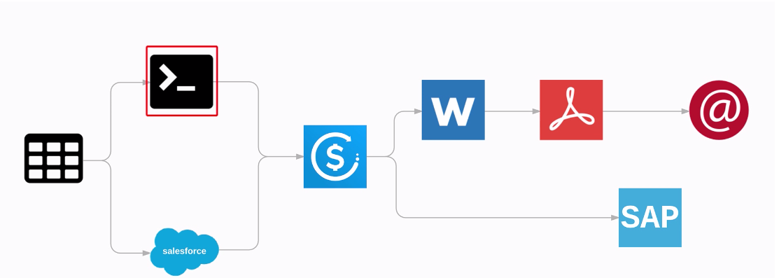
UiPath Robot
Can work with multiple applications simultaneously

Slide 10
Virtual desktop
Can work with remote desktop, citrix, vnc…
By using image recognition, google ocr, microsoft ocr...
Robot can work when the application’s position change because robot is searching for the images and image relatives

Slide 11
UiPath Orchestrator
Is the browser based server application that you can use to manage robots and processes
Using the server web console you can deploy, start, stop and schedule processes and monitor their execution by the robots.
Facilitates human-robot collaboration and business exception handling using centralized work queues

Slide 12
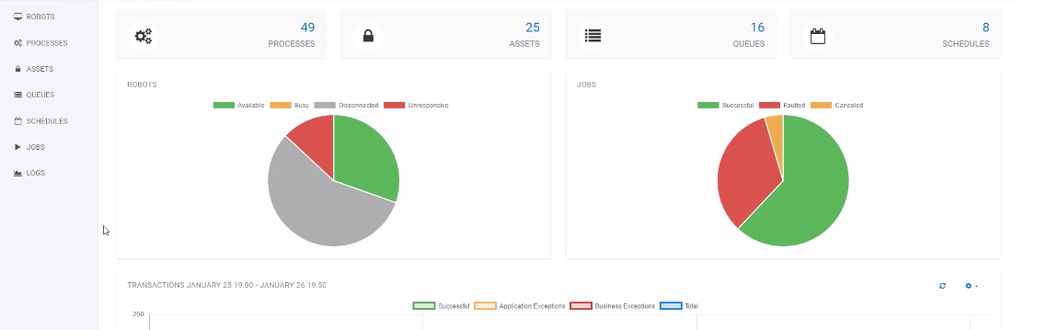
UiPath Orchestrator
Larger enterprise that uses a number of substantial robots

Slide 13
Deploy process
Link the robots with orchestrator (robot key, orchestrator url)
There are multiple version for each of package
UiPath studio publish the new version then UiPath orchestrator can deploy it on another machine.
Schedule to run a process within the time

Slide 14
Questions?

Slide 15
References
https://academy.uipath.com/lms/index.php?r=player&course_id=1#training&login=1

